Slide 1

Oracle 11g: SQL
Chapter 6
Additional Database Objects

Slide 2
Objectives
Define the purpose of a sequence and state how it can be used in a database
Explain why gaps may appear in the integers generated by a sequence
Use the CREATE SEQUENCE command to create a sequence
Call and use sequence values
Identify which options cannot be changed by the ALTER SEQUENCE command
Delete a sequence
Oracle 11g: SQL

Slide 3
Objectives (continued)
Create indexes with the CREATE INDEX command
Explain the main index structures: B-tree and bitmap
Verify index use with the explain plan
Introduce variations on conventional indexes, including a function-based index and an index organized table
Oracle 11g: SQL

Slide 4
Objectives (continued)
Verify index existence via the data dictionary
Rename an index with the ALTER INDEX command
Remove an index using the DELETE INDEX command
Create and remove a public synonym
Oracle 11g: SQL

Slide 5
Sequences
Used for internal control purposes by providing sequential integers for auditing
Used to generate unique value for primary key column
  Surrogate key = no correlation with actual row contents
Oracle 11g: SQL

Slide 6
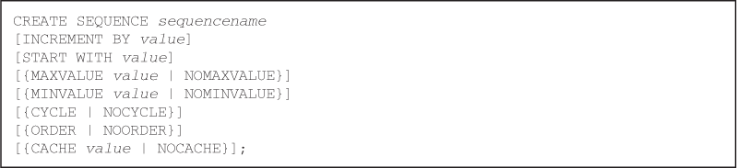
Creating a Sequence
Use the CREATE SEQUENCE command
Various intervals are allowed – Default: 1
You can specify the starting number – Default: 1
Oracle 11g: SQL

Slide 7
Creating a Sequence (continued)
Can specify MINVALUE for decreasing sequence and MAXVALUE for increasing sequence
Numbers can be reused if CYCLE is specified
ORDER clause is used in application cluster environment
Use CACHE to pregenerate integers – Default: 20
Oracle 11g: SQL

Slide 8
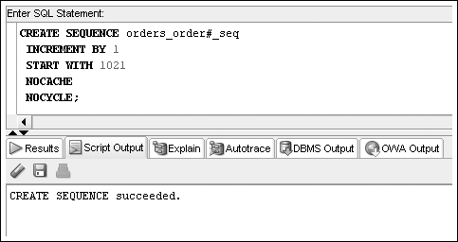
Creating a Sequence (continued)
Oracle 11g: SQL

Slide 9
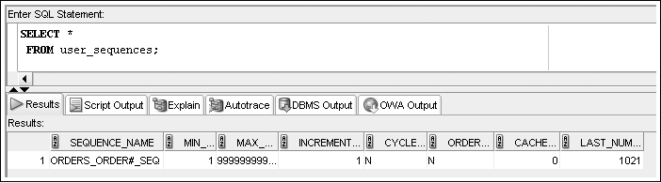
Creating a Sequence (continued)
To verify the settings for options of a sequence, query USER_SEQUENCES data dictionary view
Next Number to issue
Oracle 11g: SQL

Slide 10
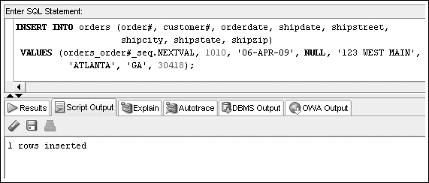
Using Sequence Values
NEXTVAL – generates integer
Oracle 11g: SQL

Slide 11
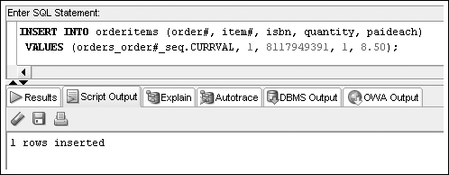
Using Sequence Values (continued)
CURRVAL – contains last integer generated by NEXTVAL
Oracle 11g: SQL

Slide 12
Altering Sequence Definitions
Use ALTER SEQUENCE command to change the settings for a sequence
START WITH value cannot be altered – drop the sequence and re-create it
Changes cannot make current integers invalid
Oracle 11g: SQL

Slide 13
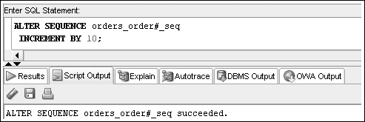
ALTER SEQUENCE Command Example
Oracle 11g: SQL

Slide 14
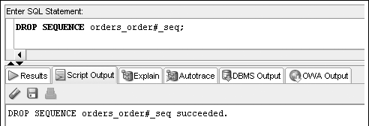
Removing a Sequence
Use the DROP SEQUENCE command to delete a sequence
Previous values generated are not affected by removing a sequence from a database
Oracle 11g: SQL

Slide 15
Indexes
An index stores frequently referenced values and ROWIDs
Can be based on one column, multiple columns, functions, or expressions
Oracle 11g: SQL

Slide 16
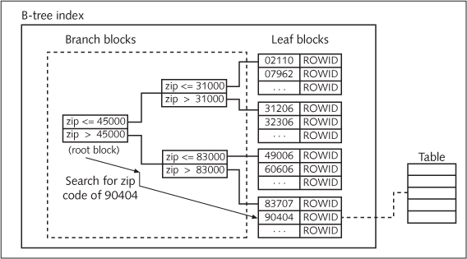
B-Tree Index
Oracle 11g: SQL

Slide 17
B-Tree Index (continued)
Implicitly create an index by PRIMARY KEY and UNIQUE constraints
Explicitly create an index by using the CREATE INDEX command
  Usually on fields that have an FK to another table so that we can quickly find ‘child’ records from that other table
Oracle 11g: SQL

Slide 18
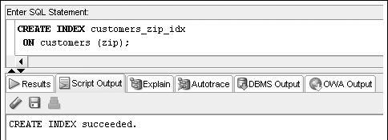
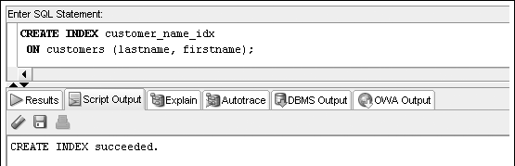
CREATE INDEX Command Examples
Oracle 11g: SQL

Slide 19
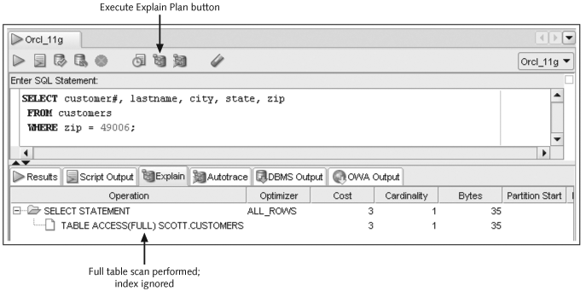
The Explain Plan
Oracle 11g: SQL

Slide 20
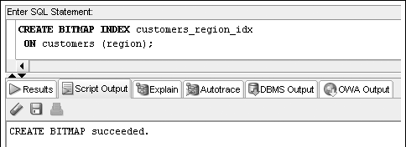
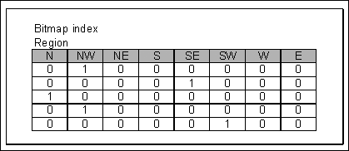
Bitmap Indexes
Oracle 11g: SQL
Notes:
REGION only has 8 possible values, so a single bit for each is sufficient

Slide 21
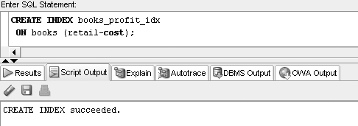
Function-Based Indexes
Oracle 11g: SQL

Slide 22
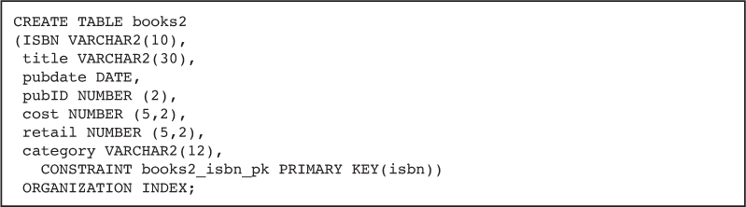
Index Organized Tables
An IOT stores table contents in a B-tree index structure
Use the “ORGANIZATION INDEX” option in a CREATE TABLE statement to build an IOT
Oracle 11g: SQL

Slide 23
Verifying an Index
Use the USER_INDEXES data dictionary view to determine that the index exists
Use the USER_IND_COLUMNS data dictionary view to determine the column index information
Oracle 11g: SQL

Slide 24
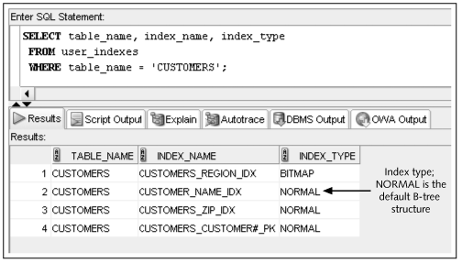
Verifying an Index (continued)
Oracle 11g: SQL

Slide 25
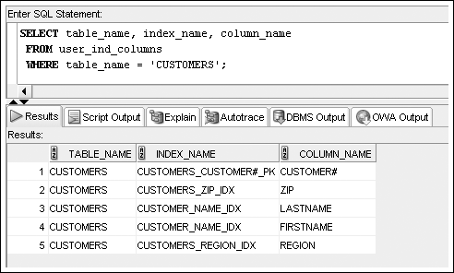
USER_IND_COLUMNS
Oracle 11g: SQL

Slide 26
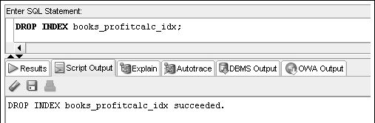
Removing an Index
Use the DROP INDEX command to remove an index
Oracle 11g: SQL

Slide 27
Synonyms
Synonyms serve as aliases for database objects,
to simplify object references
Can be private or public
  Private synonyms are only available to the user who created them
  PUBLIC synonyms are available to all database users (created by a DBA)
Oracle 11g: SQL

Slide 28
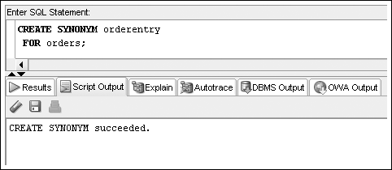
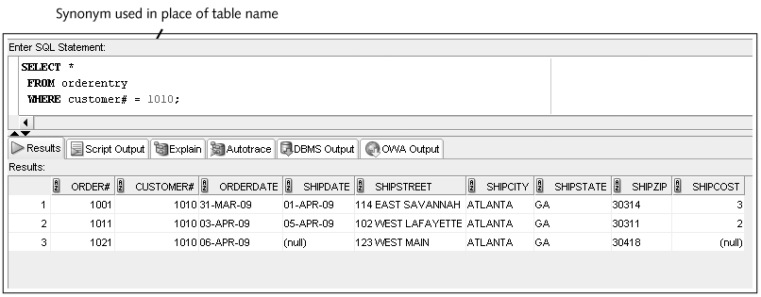

Slide 29
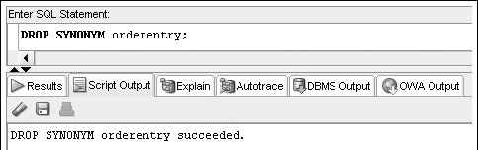
Deleting a SYNONYM
A private synonym can be deleted by its owner
A PUBLIC synonym can only be deleted by a user with DBA privileges
Oracle 11g: SQL

